Slide 1
CURE: An Efficient Clustering Algorithm for Large Databases

Slide 2
Overview
Introduction
  Drawbacks of Traditional Clustering Algorithms
  Contributions of CURE
CURE Algorithm
  Hierarchical Clustering Algorithm
  Random Sampling
  Partitioning for Speedup
  Labeling Data on Disk
  Handling Outliers
Experimental Results

Slide 3
Drawbacks of Traditional Clustering Algorithms
Centroid-based approach (using d_{mean}) considers only one point as representative of a cluster - the cluster centroid.
All-points approach (based on d_{min}) makes the clustering algorithm extremely sensitive to outliers and to slight changes in the position of data points.
Both of them can’t work well for non-spherical or arbitrary shaped clusters.

Slide 4
Contributions of CURE (Clustering Using Representatives)
CURE can identify both spherical and non-spherical clusters.
  It chooses a number of well scattered points as representatives of the cluster instead of one point - centroid.
CURE uses random sampling and partitioning to speed up clustering.

Slide 5
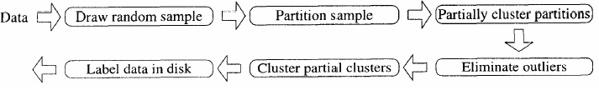
Overview of CURE

Slide 6
CURE Algorithm:
Hierarchical Clustering Algorithm
For each cluster, c well scattered points within the cluster are chosen , and then shrinking them toward the mean of the cluster by a fraction a.
The distance between two clusters is then the distance between the closest pair of representative points from each cluster.
The c representative points attempt to capture the physical shape and geometry of the cluster. Shrinking the scattered points toward the mean gets rid of surface abnormalities and mitigates the effects of outliers.

Slide 7
CURE Algorithm:
Random Sampling
In order to handle large data sets, random sampling is used to reduce the size of the input to CURE’s clustering algorithm.
[Vit85] provides efficient algorithms for drawing a sample randomly in one pass and using constant space.
Although random sampling does have tradeoff between accuracy and efficiency, experiments show that for most of the data sets, with moderate sized random samples, very good clusters can obtained.

Slide 8
CURE Algorithm:
Partitioning for Speedup
In the first pass:
  Partition the sample space into p partitions, each of size n/p.
  Partially cluster each partition until the final number of clusters in each partition reduces to n/pq, some constant q > 1.
The advantages are
  Reduce execution time
  Reduce the input size and ensure it fits in main-memory by storing only the representative points for each cluster as input to the clustering algorithm.

Slide 9
CURE Algorithm:
Labeling Data on Disk
Each data point is assigned to the cluster containing the representative point closest to it.

Slide 10
CURE Algorithm:
Handling Outliers
The number of points in a collection of outliers is typically much less than the number in a cluster.
In the first phase, proceed with the clustering until # clusters decreases to 1/3, then classify clusters with very few points (e.g., 1 or 2) as outliers.
The second phase occurs toward the end. Small groups (outliers) are easy to be identified and eliminated.

Slide 11
Experimental Results - Algorithms
BIRCH
CURE
  The partitioning constant q = 3
  Two phase outlier handling
  Random sample size = 2.5% of the initial data set size
MST (minimum spanning tree)
  When shrink factor = 0, CURE reduces to MST.

Slide 12
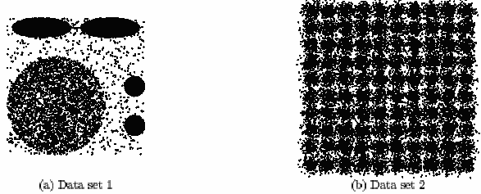
Experimental Results – Data Sets
Experiment with data sets of two dimensions
Data set 1 contains one big and two small circles.
Data set 2 consists of 100 clusters with centers arranged in a grid pattern and data points in each cluster following a normal distribution with mean at the cluster center.

Slide 13
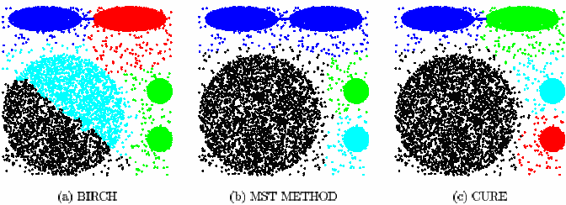
Experimental Results – Quality of Clustering
BIRCH cannot distinguish between the big and small clusters.
MST merges the two ellipsoids.
CURE successfully discovers the clusters in Data set 1.

Slide 14
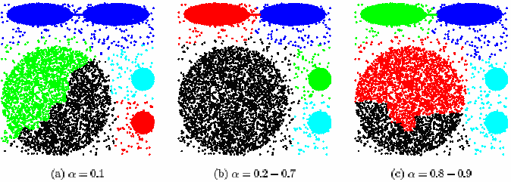
Experimental Results – Sensitivity to Parameters
Shrink Factor a:
0.2 – 0.7 is a good range of values for a.

Slide 15
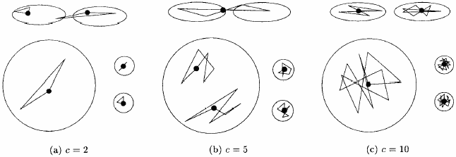
Experimental Results – Sensitivity to Parameters (Contd)
Number of Representative Points c:
For smaller values of c, the quality of clustering suffered.
However, for values of c greater than 10, CURE always found right clusters.

Slide 16
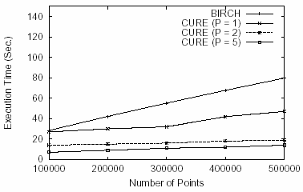
Experimental Results – Comparison of Execution time to BIRCH
Run both BIRCH and CURE on Data set 2:

Slide 17
Conclusion
CURE can adjust well to clusters having non-spherical shapes and wide variances in size.
CURE can handle large databases efficiently.

